Slide 1
Project 4B – Face Replacement
Group 15
- Harshal Godhia
- Bhairavi Mehta

Slide 2
Approach
Facial feature extraction using HOG features
Build codebook from training images
Face Detection : vision.CascadeObjectDetector()
Face Tracking : KLT algorithm
Facial feature detection using Voting method to obtain the control points for the eyes, nose and mouth
TPS warping using the corresponding control points
Poisson Image Editing

Slide 3
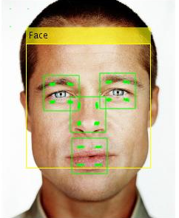
HOG Feature Extraction
Eg. of a codebook entry
[x,y,HOGfeatureVector,Nose]
(x,y) are the x and y coordinates of the point at which the feature vector has been computed
HOG is the 1xk feature vector at (x,y)
Nose is the label of the feature

Slide 4

Facial Feature Detection using Voting
Compute the size of the sliding window (bounding_box_test_size)*(cell_train_size)/(bounding_box_train_size)
Find top k matches in the codebook for each patch in the test image using Chi-square distance
Compute position of each feature from the current patch and add this score at that position
Blur the 5*5 patch at this computed position using a 5*5 gaussian filter with sigma=0.5
Threshold the voting scores above the mean of the scores and then select the centroid of the remaining positions as the location of the corresponding feature

Slide 5
Facial Feature Detection using Voting

Slide 6
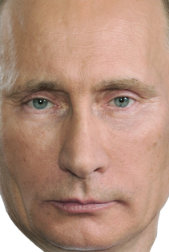
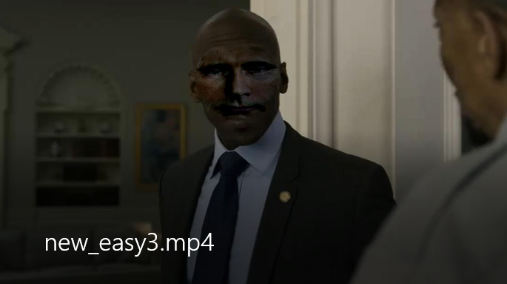
TPS Warping & Poisson Image Editing

Slide 7
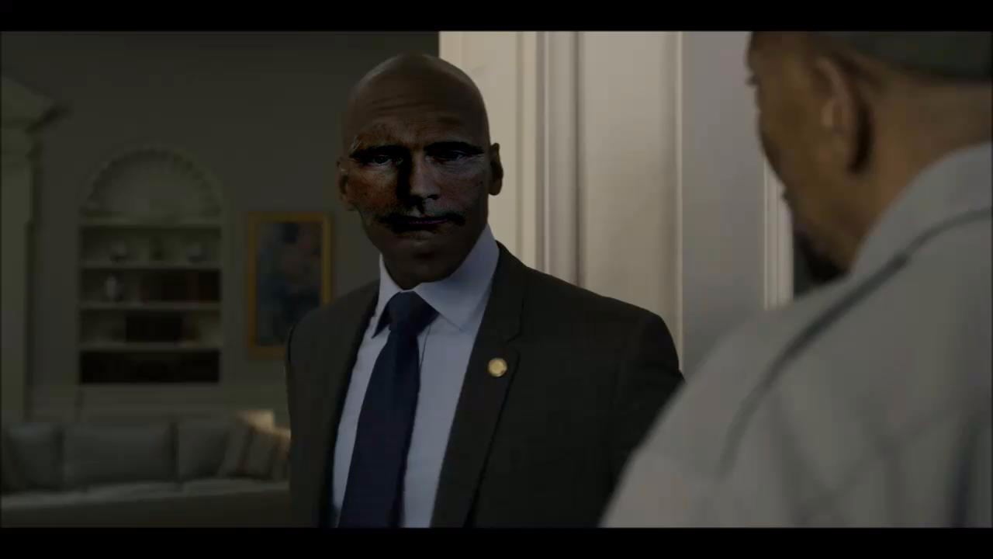
Results

Slide 8

Results

Slide 9
Thank You

